Slide 1


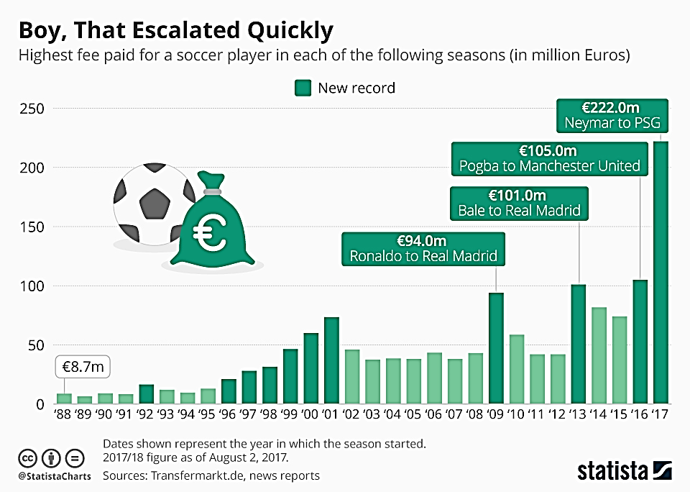
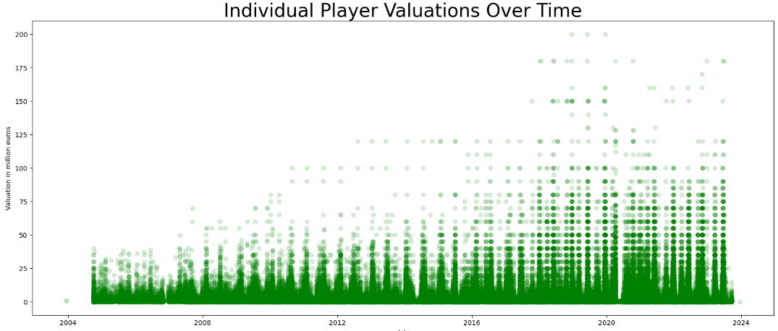
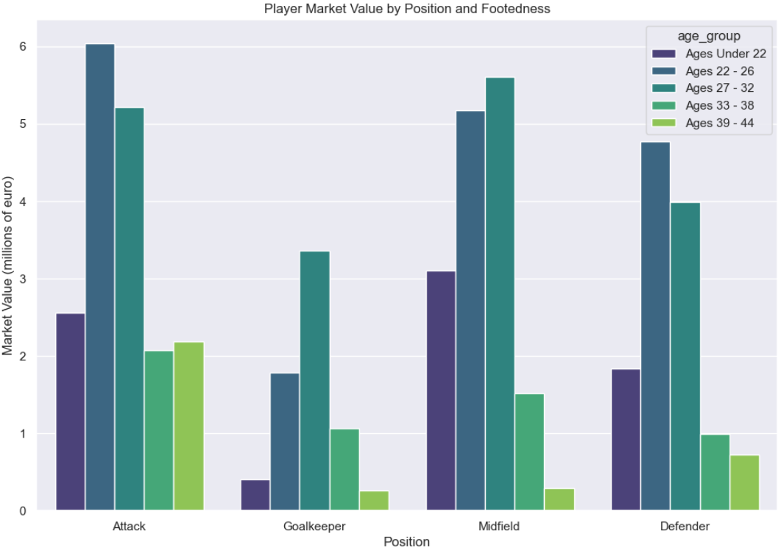
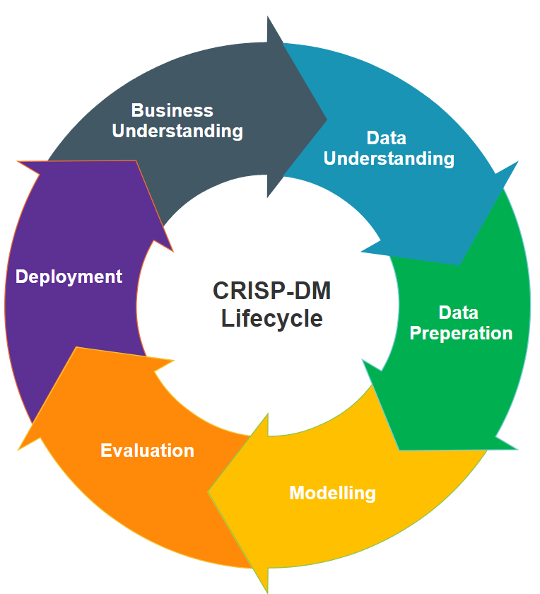

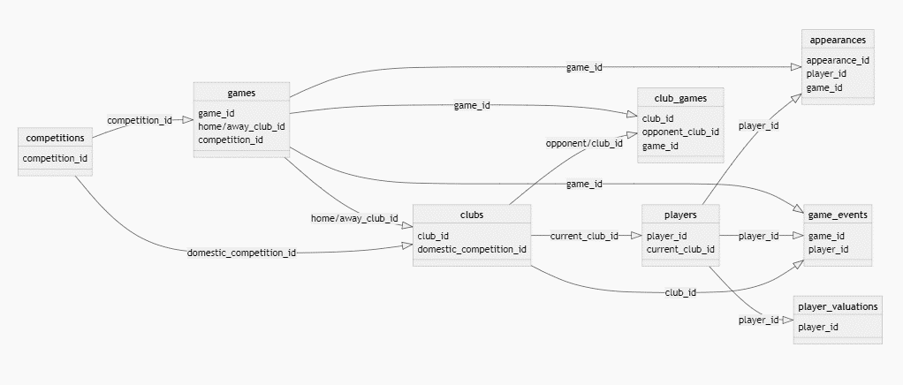
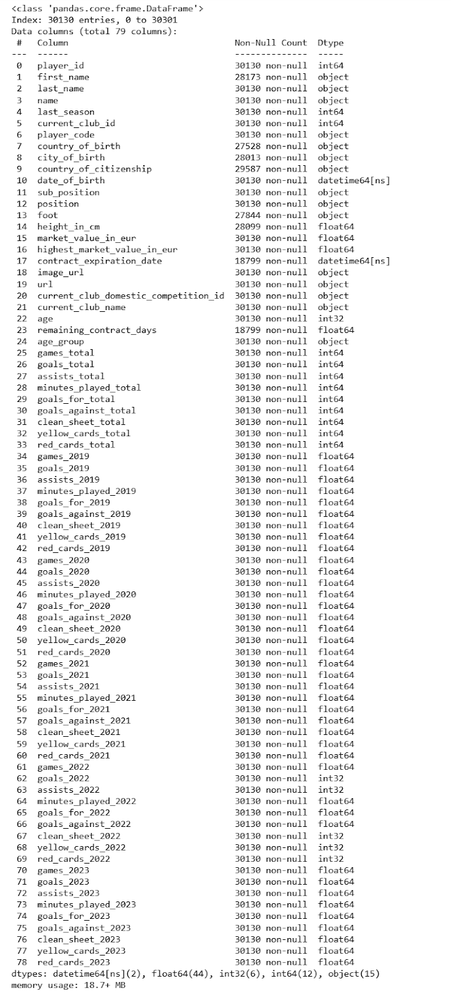
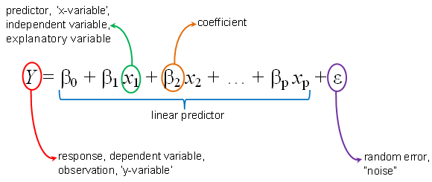
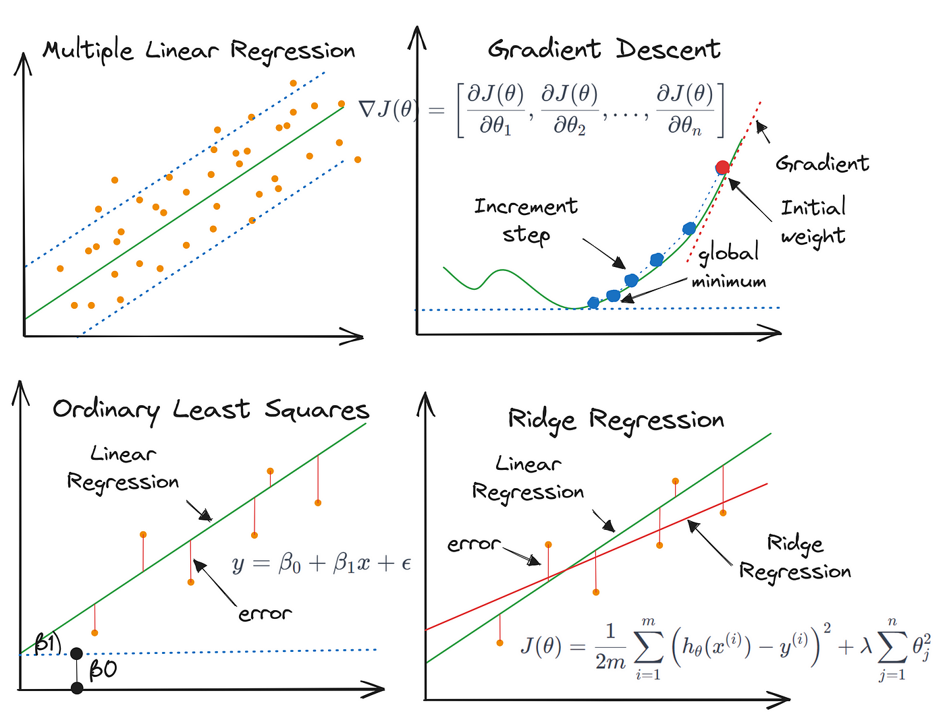
Leveraging Machine Learning and Data Science for Competitive Advantage: Estimating Football Player Market Values
Author: Kavi Patak Lecturer: James Garza
Introduction
2. Exploratory Data Analytics
The role of analytics in football has evolved over the past decade, and will continue to do so. Technological developments continue to improve the volume and quality of data available to the world’s leading clubs, as well as the ability to derive insight from them. The opportunity exists for clubs of all sizes to use analytics to build a sustainable competitive advantage, something which will be most evident in the area where they invest most: the transfer market.
The Process…
Business Understanding
3. Preprocessing
The role of analytics in football has evolved over the past decade, and will continue to do so. Technological developments continue to improve the volume and quality of data available to the world’s leading clubs, as well as the ability to derive insight from them. The opportunity exists for clubs of all sizes to use analytics to build a sustainable competitive advantage, something which will be most evident in the area where they invest most: the transfer market.
The role of analytics in football has evolved over the past decade, and will continue to do so. Technological developments continue to improve the volume and quality of data available to the world’s leading clubs, as well as the ability to derive insight from them. The opportunity exists for clubs of all sizes to use analytics to build a sustainable competitive advantage, something which will be most evident in the area where they invest most: the transfer market.
Evaluation
Data Understanding
1. Merging and Characterising the Data
Modelling
Data: “Football Data from Transfermarkt” provided by Kaggle
Available at: https://www.kaggle.com/datasets/davidcariboo/player-scores/versions/284
9 CSV Files
appearances_df : (1485697, 13)
club_games_df : (128586, 11)
clubs_df: (426, 16)
competitions_df: (43, 10)
game_events_df: (652010, 10)
game_lineups_df : (86822, 9)
games_df : (64293, 23)
player_valuations_df : (440663, 9)
players_df: (30302, 23)
Deployment
The Combined
Conclusion
References

Slide 2
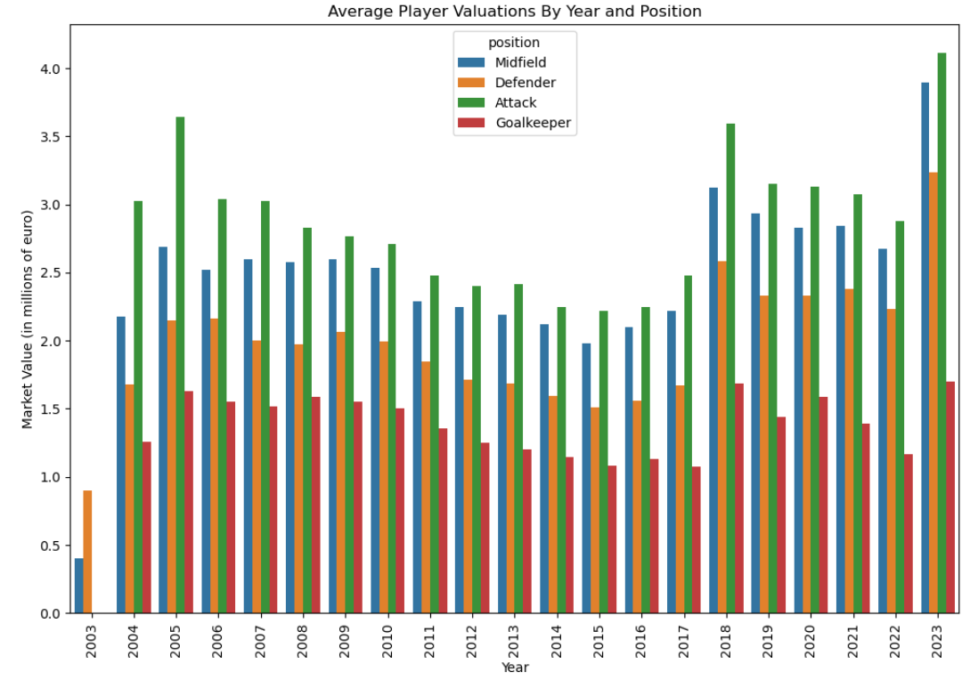
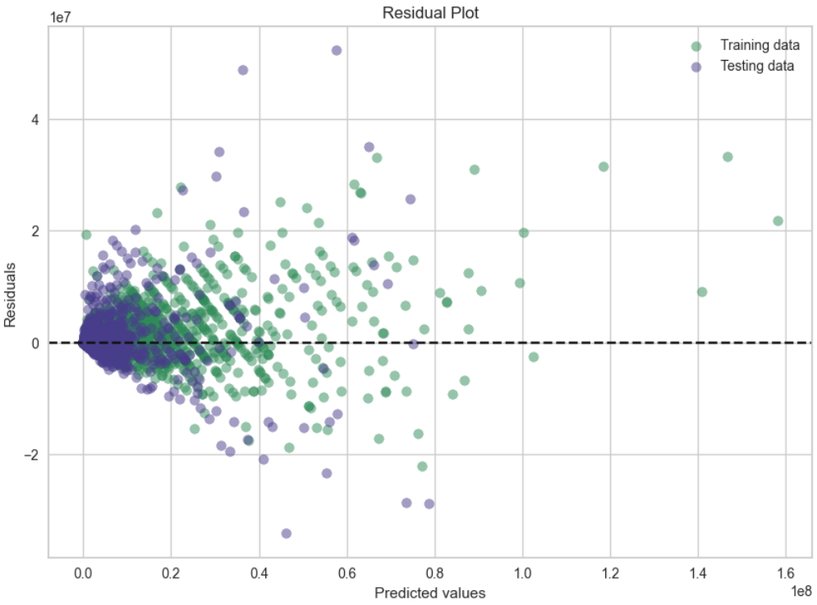
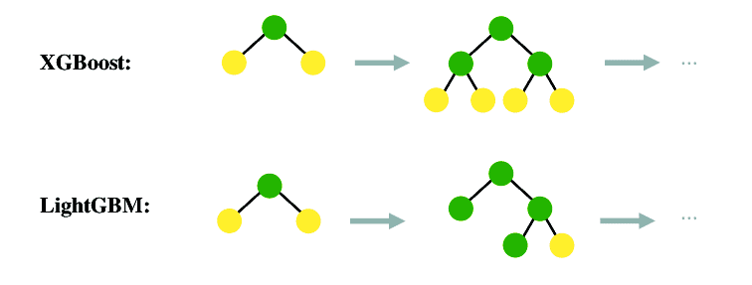
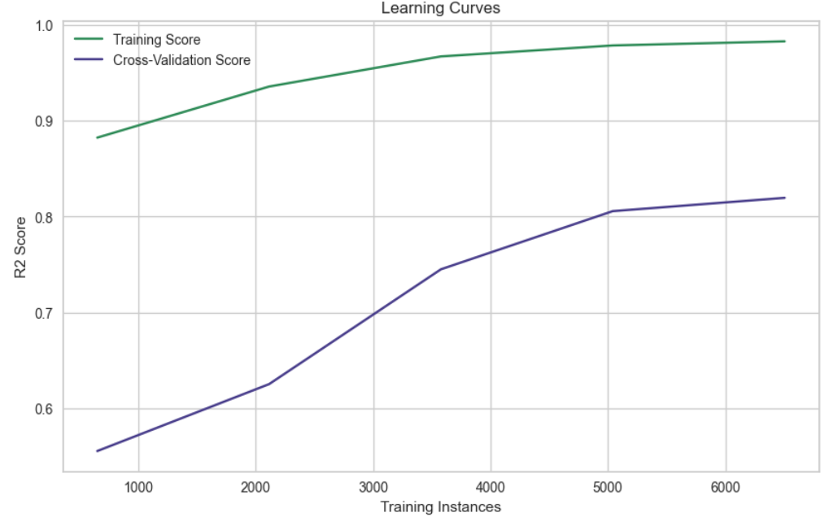

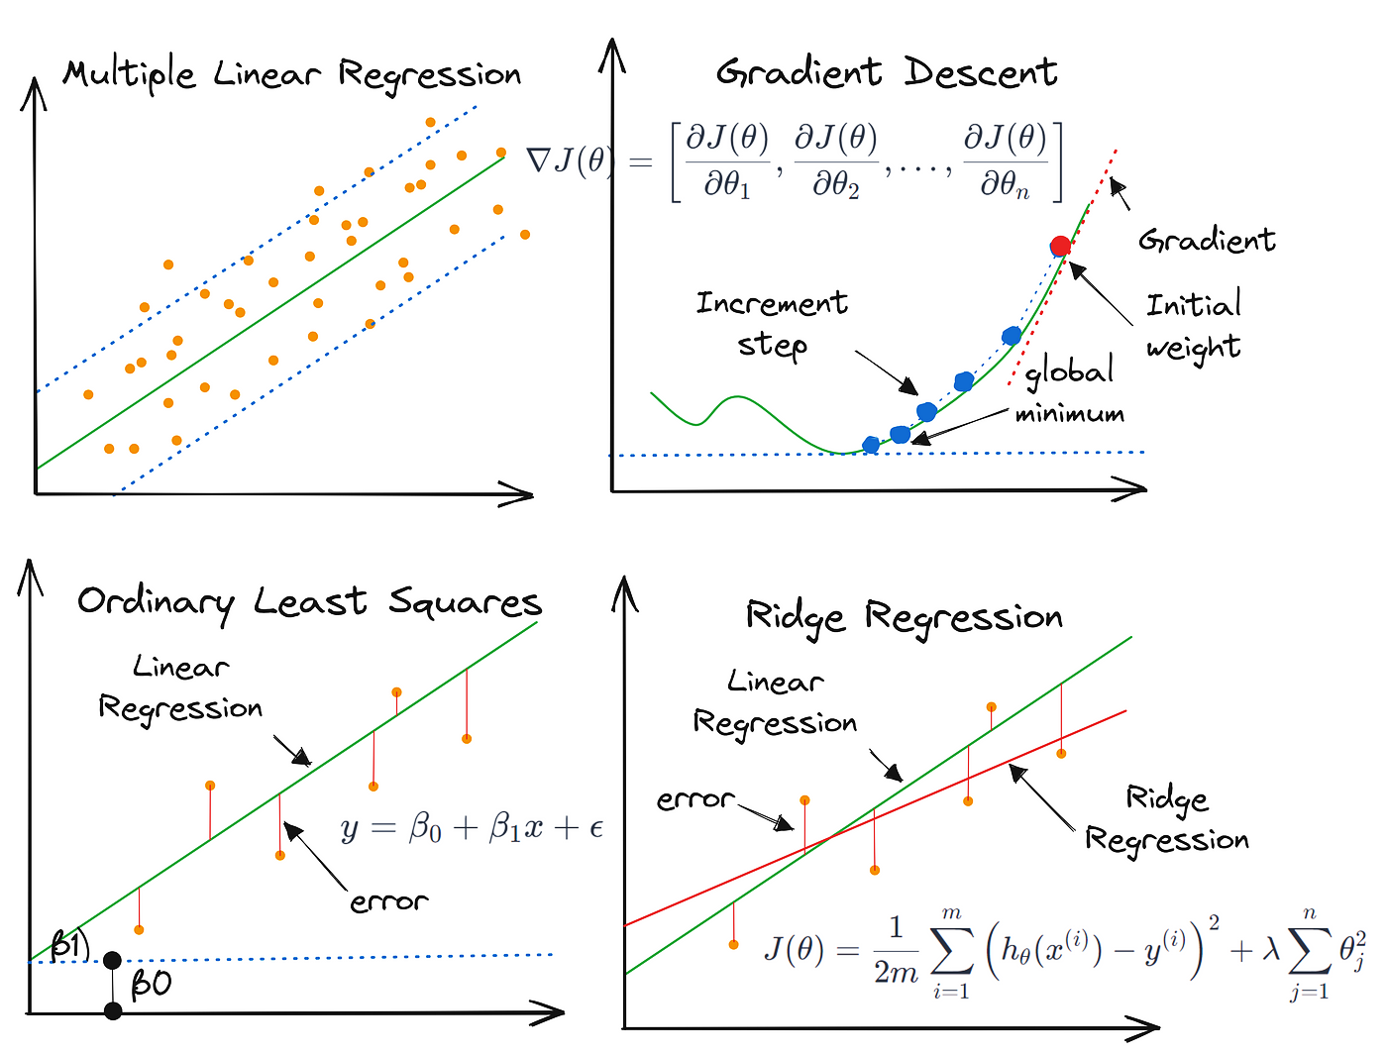
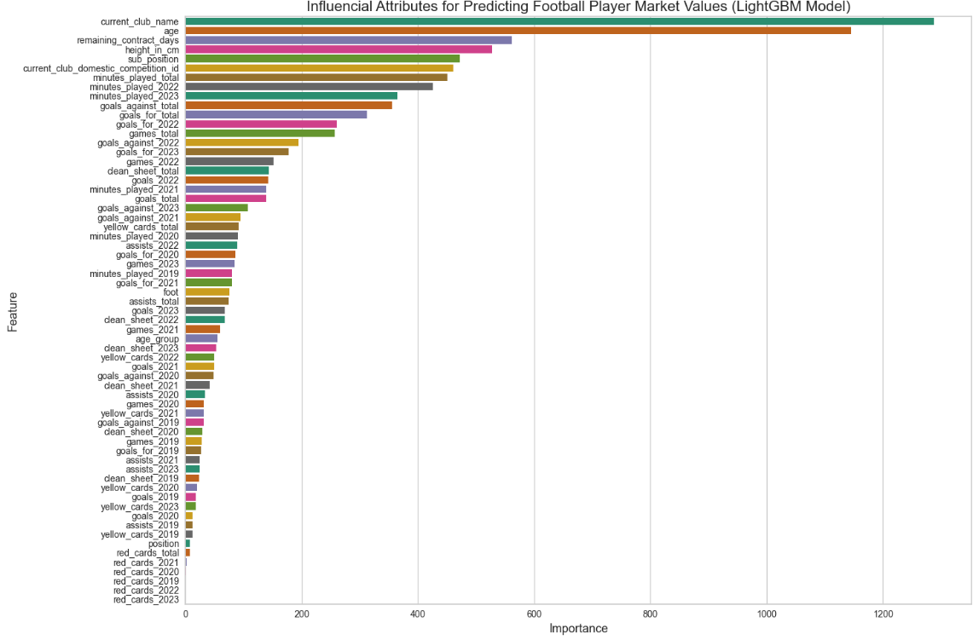
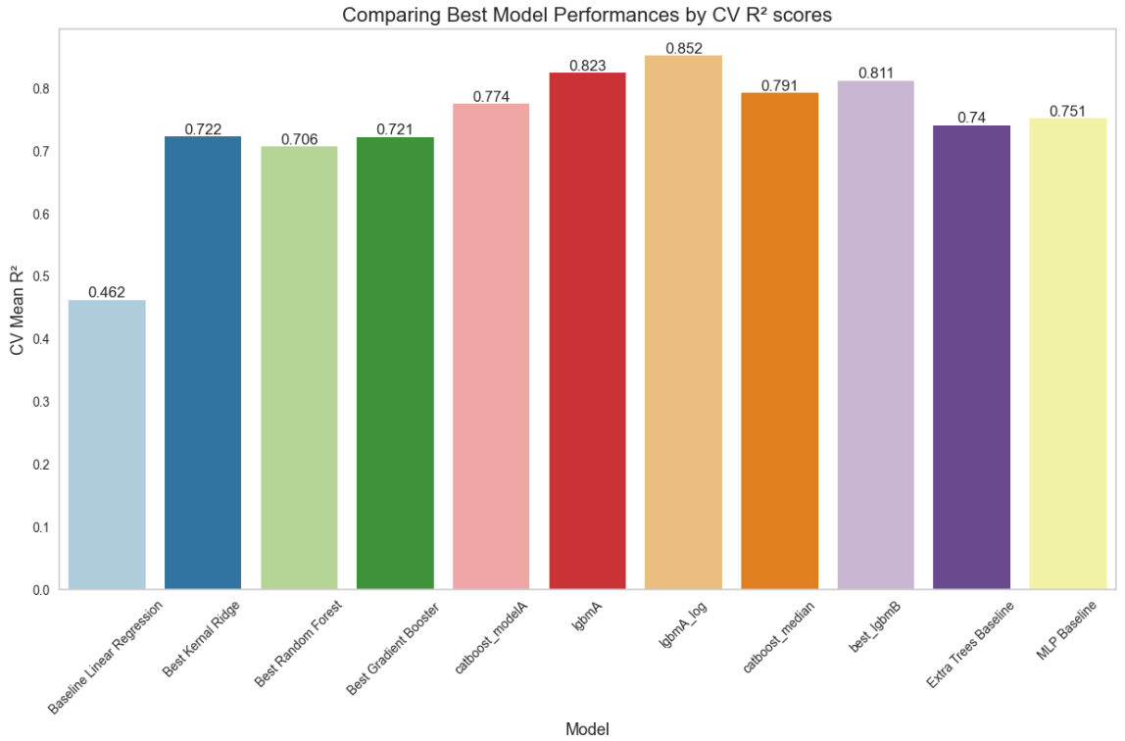
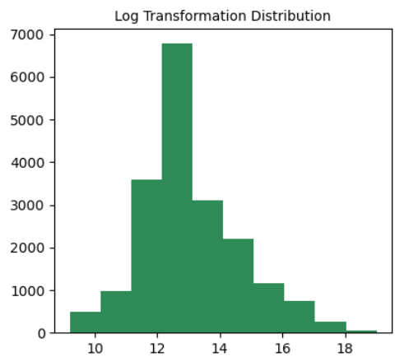
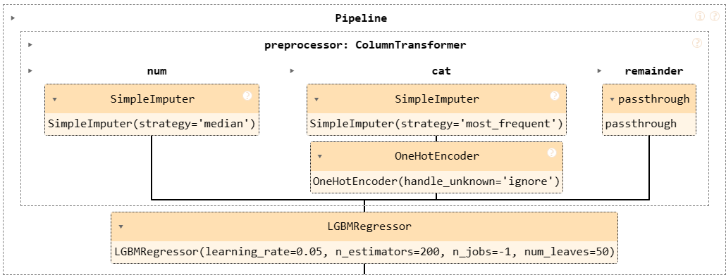
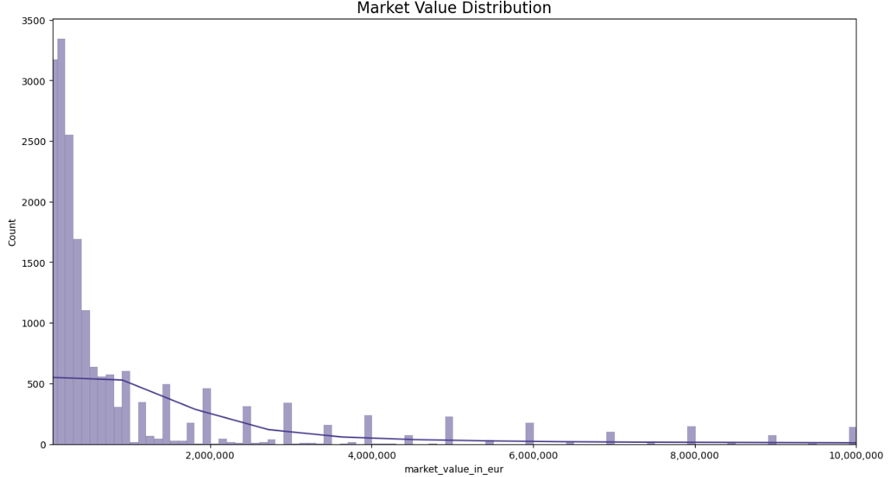
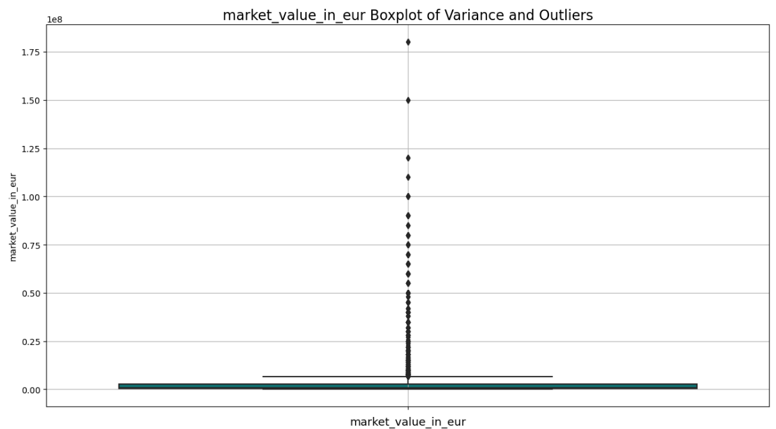









Leveraging Machine Learning and Data Science for Competitive Advantage: Estimating Football Player Market Values
Author: Kavi Patak Lecturer: James Garza
Introduction
LightGBM adopts a leaf-wise growth strategy, as opposed to the traditional level-wise approach. The fundamental difference lies in how the tree grows and how branches expand.
The role of analytics in football has evolved over the past decade, and will continue to do so. Technological developments continue to improve the volume and quality of data available to the world’s leading clubs, as well as the ability to derive insight from them. The opportunity exists for clubs of all sizes to use analytics to build a sustainable competitive advantage, something which will be most evident in the area where they invest most: the transfer market.
The tree grows by adding a leaf that provides the maximum gain at each expansion step. In other words, only one leaf node is added at each expansion step.
The Methodology…
Business Understanding
This initial phase focuses on understanding the project objectives and requirements from a business perspective. It involves understanding what the stakeholders want to achieve, defining the project goals, and translating these goals into Data Analytics and Machine Learning objectives.
Data Preparation
Data preparation and preprocessing is a crucial step in any Data Science project’s lifecycle. It involves several operations and transformations being applied to raw data to make it suitable for analysis and modelling.
Evaluation
This initial phase focuses on understanding the project
objectives and requirements from a business perspective. It involves understanding what the stakeholders want to achieve, defining the project goals, and translating these goals into Data Analytics and Machine Learning objectives.
Preprocessing
After building models, they need to be evaluated to determine their performance and effectiveness. This phase involves assessing the models' performance using appropriate evaluation metrics and techniques. It may also involve comparing different models to select the best one for deployment.
The aim is to enhance the quality of the data by:
addressing missing or inconsistent values,
handling various data types including type casting,
number formatting, and label encoding categorical variables,
transforming the data using standardisation or normalisation techniques,
and conducting feature engineering.
Consolidating and Characterising the Data
Data Understanding
In this phase, we gather and understand the data required for the project. This includes identifying data sources, collecting data, and exploring its structure, quality, and content. It's important to assess whether the available data is sufficient to address the project
objectives.
Merged Dataset
Data: “Football Data from Transfermarkt” provided by Kaggle
Modelling
Available at: https://www.kaggle.com/datasets/davidcariboo/player-scores/versions/284
9 CSV Files:
appearances_df : (1485697, 13)
club_games_df : (128586, 11)
clubs_df: (426, 16)
competitions_df: (43, 10)
game_events_df: (652010, 10)
game_lineups_df : (86822, 9)
games_df : (64293, 23)
player_valuations_df : (440663, 9)
players_df: (30302, 23)
Deployment
In this phase, you build and evaluate models to address the project objectives. This could involve selecting appropriate modelling techniques, building different models, and tuning their parameters.
Exploratory Data Analytics
The objective is to predict the market value of a player, which is continuous data, making this a regression problem. As we are measuring the relationships between multiple independent variables to the target variable, it is a multiple regression problem. Furthermore, we are using labelled data making this a supervised ML application.
Once a satisfactory model is identified, it needs to be deployed into production. This phase involves implementing the model into the operational environment, integrating it with existing systems, and providing documentation and support for end-users.
EDA is a process of examining the available data to discover patterns of correlation, identify trends, and gain insights of interest. It aids in spotting anomalies, testing hypotheses and clarifying any assumptions.
We find that the target variable data, ‘Market Value’, is right skewed, and requires a log transformation for normal distribution. The data also contains multiple outliers identifiable through the box plot below.
Through EDA we discover similar patterns and irregularities within the independent variables used for predicting. These findings will influence preprocessing decisions and techniques applied in Machine Learning.
Conclusion
The CRISP-DM methodology is iterative, meaning that it often requires going back and forth between different phases as new insights are gained or requirements change. For example, if the evaluation phase reveals that the model performance is not satisfactory, you may need to revisit the data preparation or modelling phases to make improvements.
Tools...
References…

Slide 3
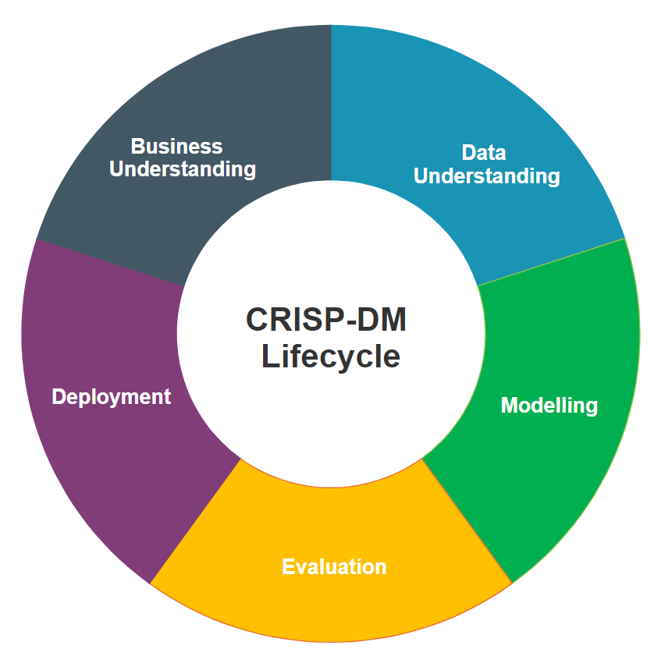
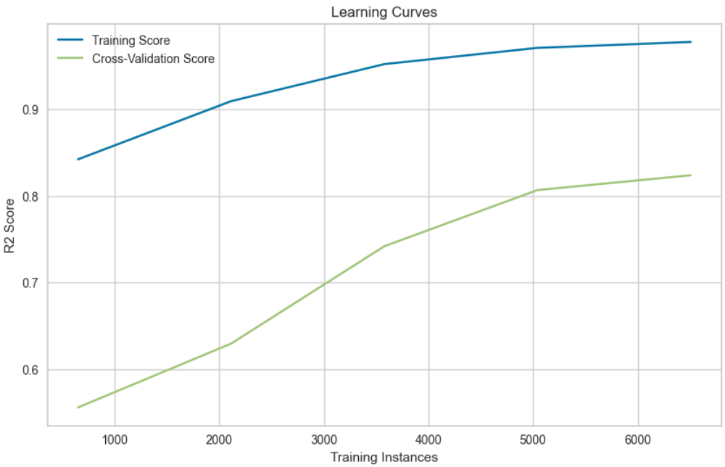
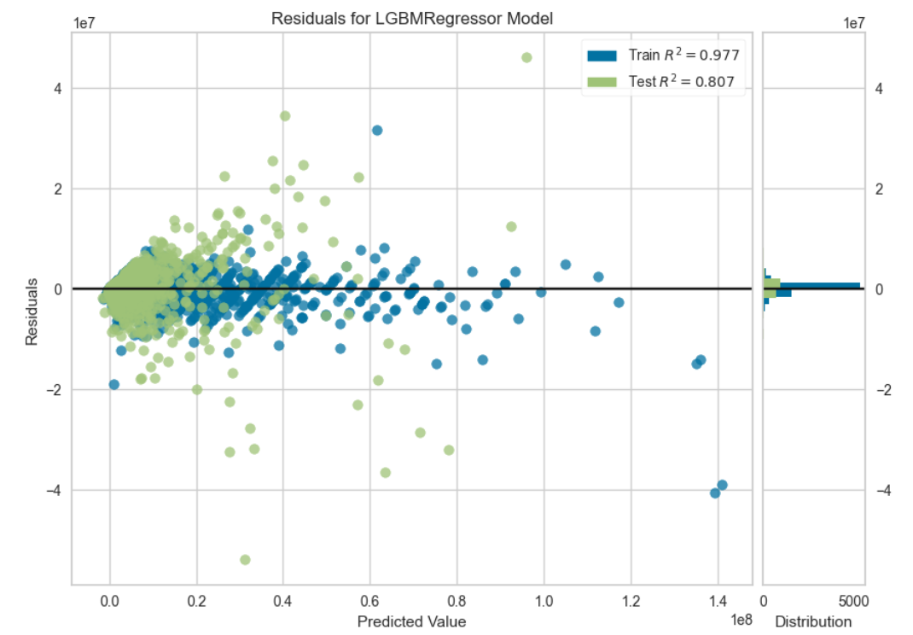
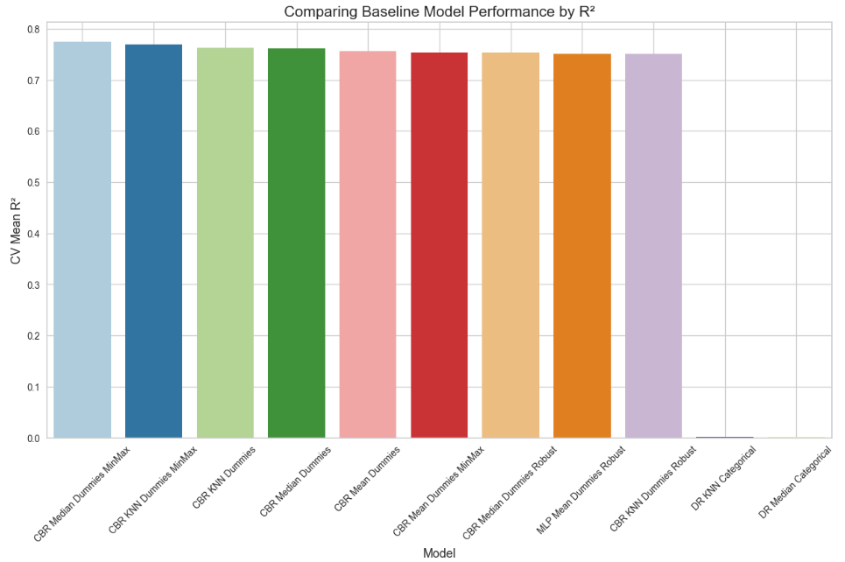
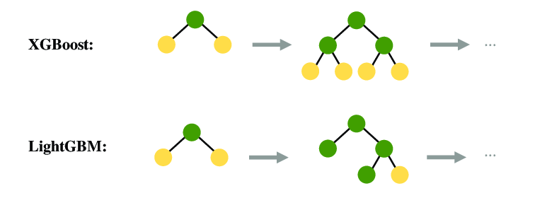
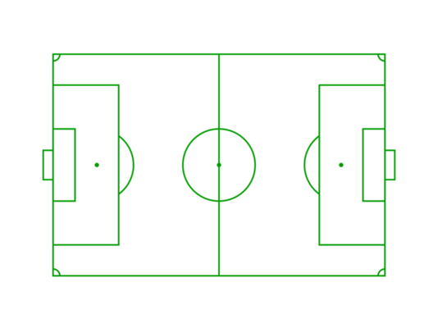


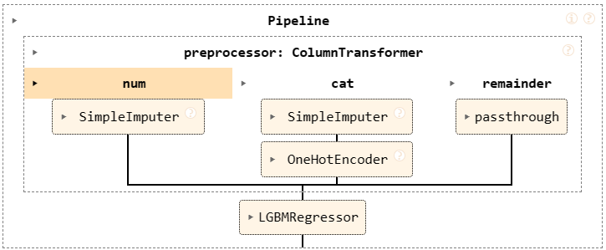
Leveraging Machine Learning and Data Science for Competitive Advantage: Estimating Player Market Values
By Kavi Patak
Introduction
The role of analytics in football has evolved over the past decade, and will continue to do so. Technological developments continue to improve the volume and quality of data available to the world’s leading clubs, as well as the ability to derive insight from them. The opportunity exists for clubs of all sizes to use analytics to build a sustainable competitive advantage, something which will be most evident in the area where they invest most: the transfer market.
The Process…
Business Understanding
The role of analytics in football has evolved over the past decade, and will continue to do so. Technological developments continue to improve the volume and quality of data available to the world’s leading clubs, as well as the ability to derive insight from them. The opportunity exists for clubs of all sizes to use analytics to build a sustainable competitive advantage, something which will be most evident in the area where they invest most: the transfer market.
Evaluation
Data Understanding
Modelling
The role of analytics in football has evolved over the past decade, and will continue to do so. Technological developments continue to improve the volume and quality of data available to the world’s leading clubs, as well as the ability to derive insight from them. The opportunity exists for clubs of all sizes to use analytics to build a sustainable competitive advantage, something which will be most evident in the area where they invest most: the transfer market.
The role of analytics in football has evolved over the past decade, and will continue to do so. Technological developments continue to improve the volume and quality of data available to the world’s leading clubs, as well as the ability to derive insight from them. The opportunity exists for clubs of all sizes to use analytics to build a sustainable competitive advantage, something which will be most evident in the area where they invest most: the transfer market.
Deployment
This usually results in deeper but narrower trees. Deeper trees can offer more flexibility to capture complex feature relationships.
It is generally faster compared to the level-wise approach.

Slide 4
